Slide 1

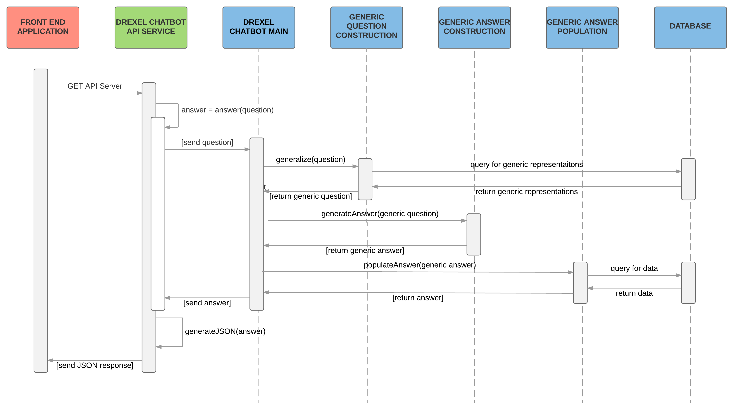
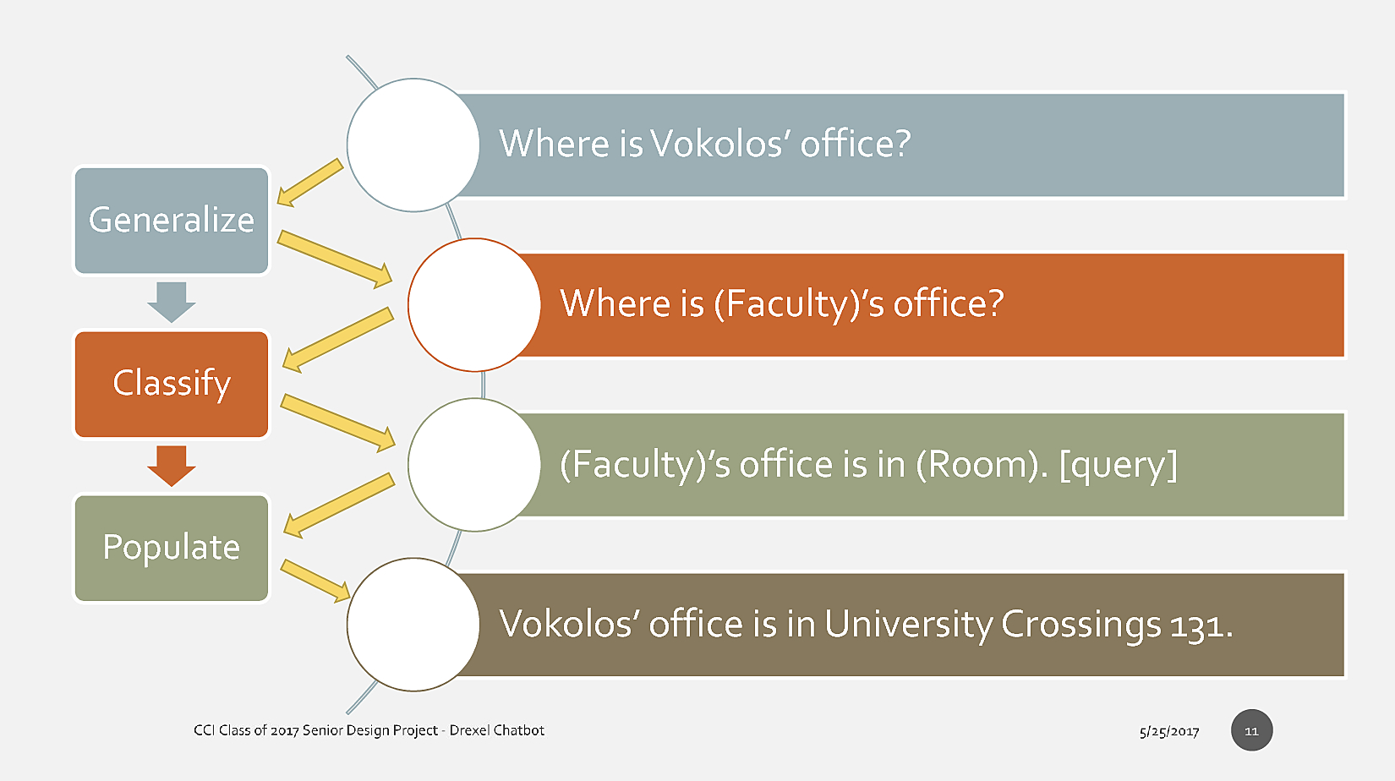
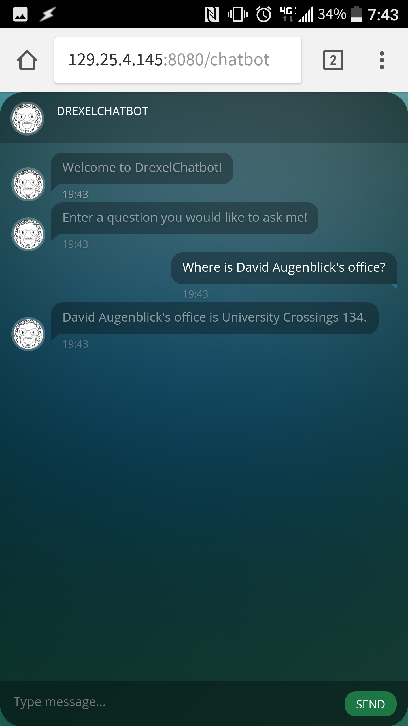
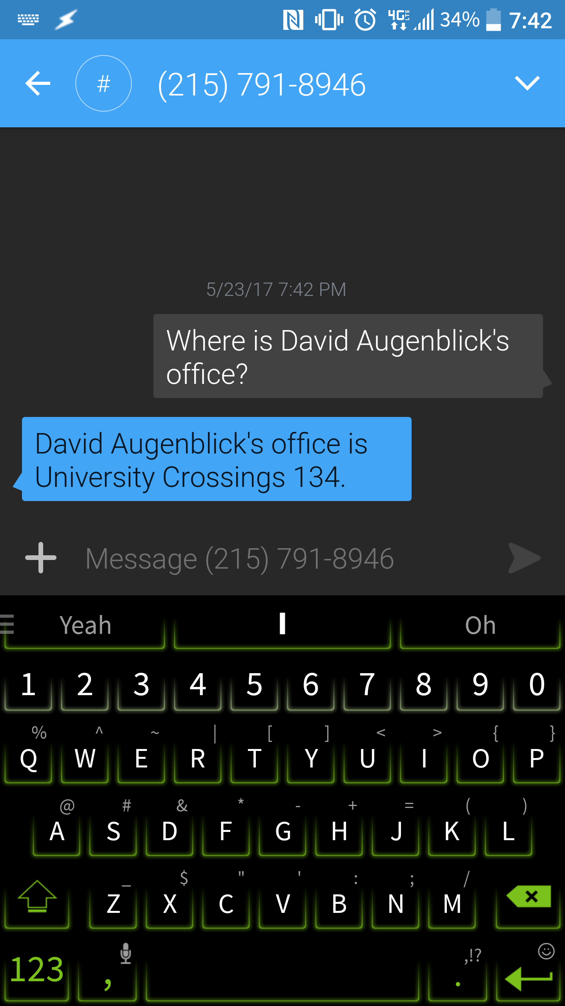
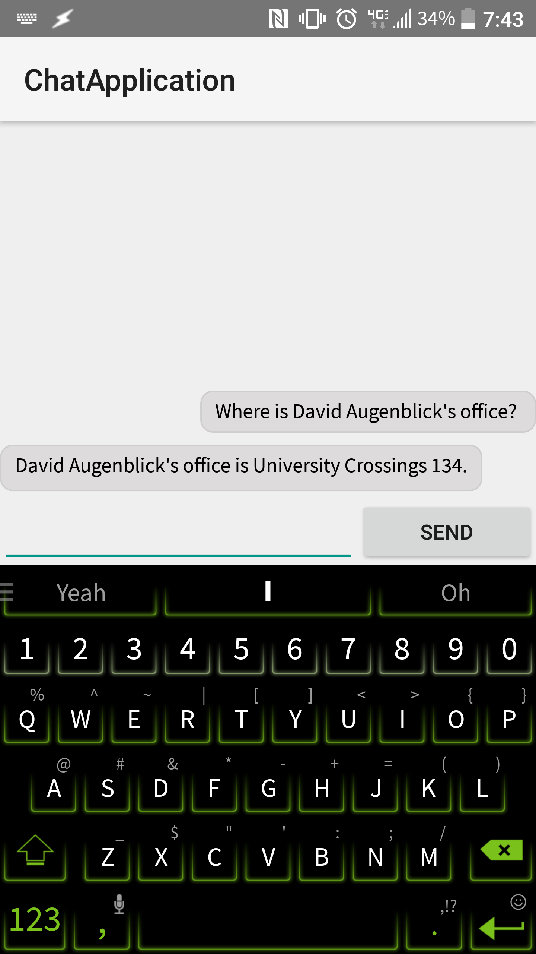
Drexel Chatbot
Tom Amon, Aaron Campbell, Daniel Fitzick, Shishir Kharel, Hoa Vu, Nanxi Zhang | Marcello Balduccini | Filippos Vokolos | Drexel University CCI | 2017
Abstract
Training
System Architecture
A web-based API for a chatbot that is capable of answering natural English questions about Drexel University, using a neural network.
To provide answers to questions in natural English, Drexel Chatbot uses a machine learning technique called neural network. A large set of questions with known answers was created as training data. This data is used to ”teach” the neural network how to answer new questions.
Training Data
Neural Network Training
New Question
Trained Neural Network
Predicted Answer
Introduction
Information about Drexel faculty and facilities are scattered across many websites. One typically has to use a search engine to find a website, and then search that website itself for the information they seek. Repeatedly searching for information like this is very tedious.
Drexel Chatbot solves this problem by simply answering the user’s questions using natural English. For example:
“What is Mongan’s email?”
“Where is Vokolos’ office?“
“Where is Rush?”
Information needed to answer these questions has been gathered into a single database. Drexel Chatbot is able to query that information and form natural English sentences that answer the user’s questions.
Additionally, Drexel Chatbot provides an API, accessible for anyone to use to integrate the service into their own applications.
Solution
Information Extraction
Instead of training the neural network on every possible question, Drexel Chatbot uses generalized questions. Generalized questions do not contain specific subjects (e.g. a professor's name), but instead generic placeholders (e.g. "(faculty)"). This allows Drexel Chatbot to answer questions about all subjects in our database without training on each individual.
Drexel Chatbot requires information from Drexel’s websites to answer questions. Most of them organize information differently, which makes it impossible to use a single algorithm to collect all required data. As a result, Drexel Chatbot extracts the information from each website using an individual algorithm. This information is then stored in a database to be used by Drexel Chatbot.
Screenshots
Features
Natural Language Processing
Questions are asked in natural English
API
RESTful API
Interfaces
Web
Answers are given in natural English
Input URL parameters
Output JSON
Concurrent users
Android
SMS
Supported Questions
Generalize
Replaces keywords with generic representations, creating a generic question.
Classify
Uses trained neural network to predict a generic answer to a generic question.
Populate
Queries the database in order to make the generic answer specific to the original question.
Faculty
Email
Faculty
Picture
Building
Address
Website
Title
Office
Phone Number
Department
Education
Publications
Research Interests
Schedule
Picture
Website
Limitations
Drexel Chatbot does not accept compound questions. In addition, each question is answered independently and previous answers do not provide context. Finally, Drexel Chatbot requires correct keywords to generalize sentences. If it fails to identify keywords, then it cannot answer the question.

